Slide 1
Information Technology Fundamentals
DT228/1
Tutorial 6 – User Centredness
Thursday 27th October 2016

Slide 2
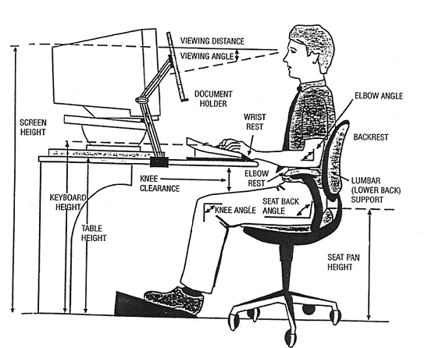
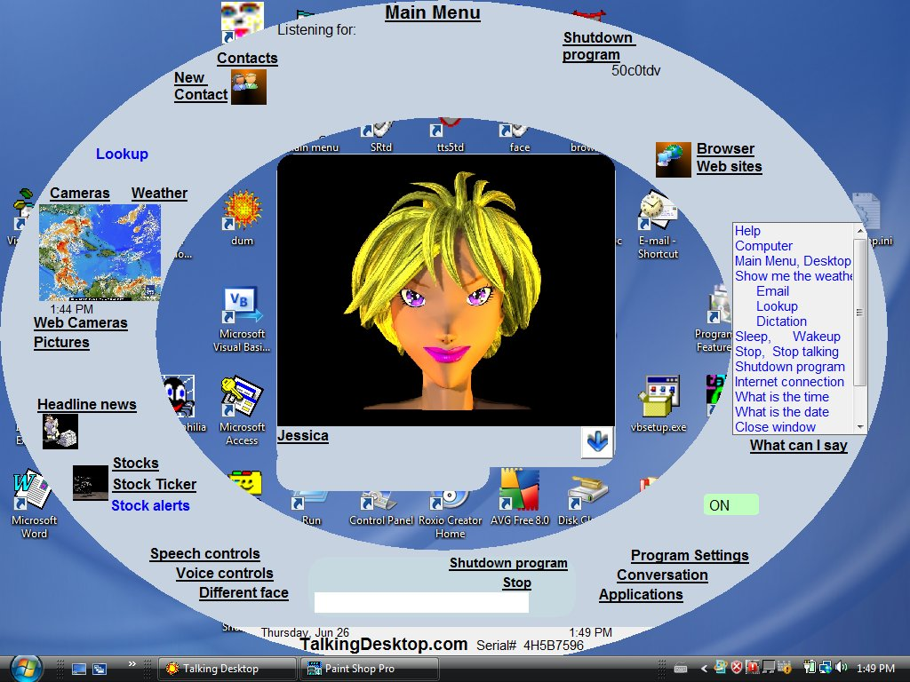
User Centredness
The ‘easy computer interface’
Ergonomics: physical - and through IT (AND SYSTEMS) design

Slide 3
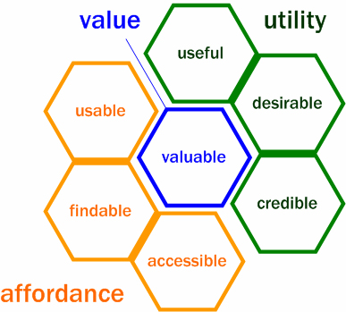
User Experience
User Experience is the sum experience of a user interacting with a product.
Bloodworth and Thompson, 2007: JA-SIG Unconference

Slide 4
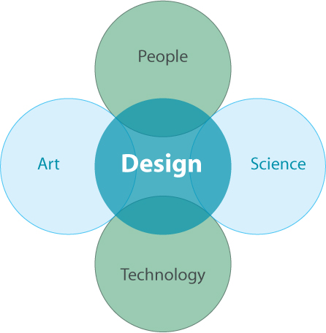
User Centred Design
Bloodworth and Thompson, 2007: JA-SIG Unconference

Slide 5
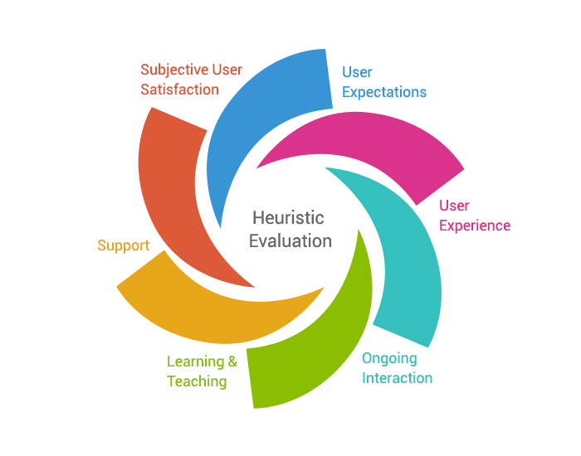
Testing for User Centredness
Heuristic evaluation is a method of user testing, which enables a product to be assessed in order to identify usability problems – that is, places where the product is not easy to use.

Slide 6



A Happy System User

